Slide 1



College ERP [Django] Category : DevOps using Amazon AWS
LEVEL 3 PPT PRESENTATION
Date :
Details of the Learner
Name : Aayush Sahay
Course : MCA 4th –AKU
Session : 2024- 2026
Enrollment : 24326711019
Guide : Dr. Amit Kumar Shukla (HOD-IT)
Institution : Cimage Center of Digital Technology
and Entrepreneurship, Patna
Course Code : 326 College Code : 711 For attainment of requirements for fulfillment of Masters in Computer Applications

Slide 2

College ERP [Django] Category : DevOps using Amazon AWS
Key Contents LEVEL 3 PPT PRESENTATION
Recommended: [Improve GUI for Forms]
Hosting on EC2 Server
Date :

Slide 3
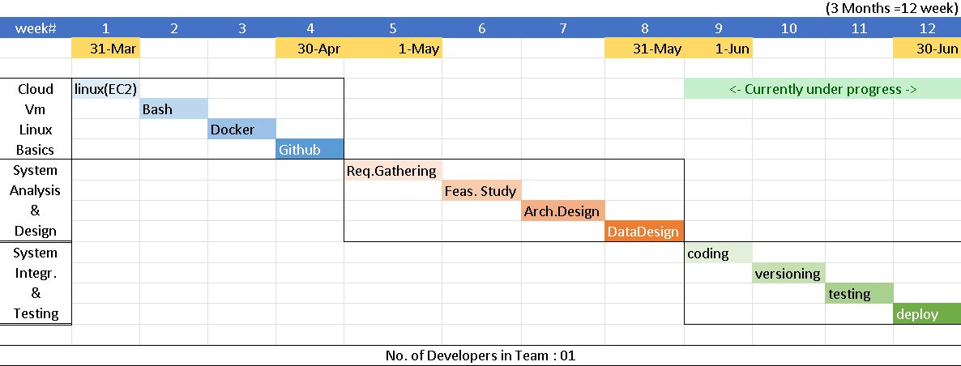
College ERP [Django] Category : DevOps using Amazon AWS
LEVEL 3 PPT PRESENTATION
Gantt Chart (3 Months Developer : 01)
To the Database
Date :

Slide 4
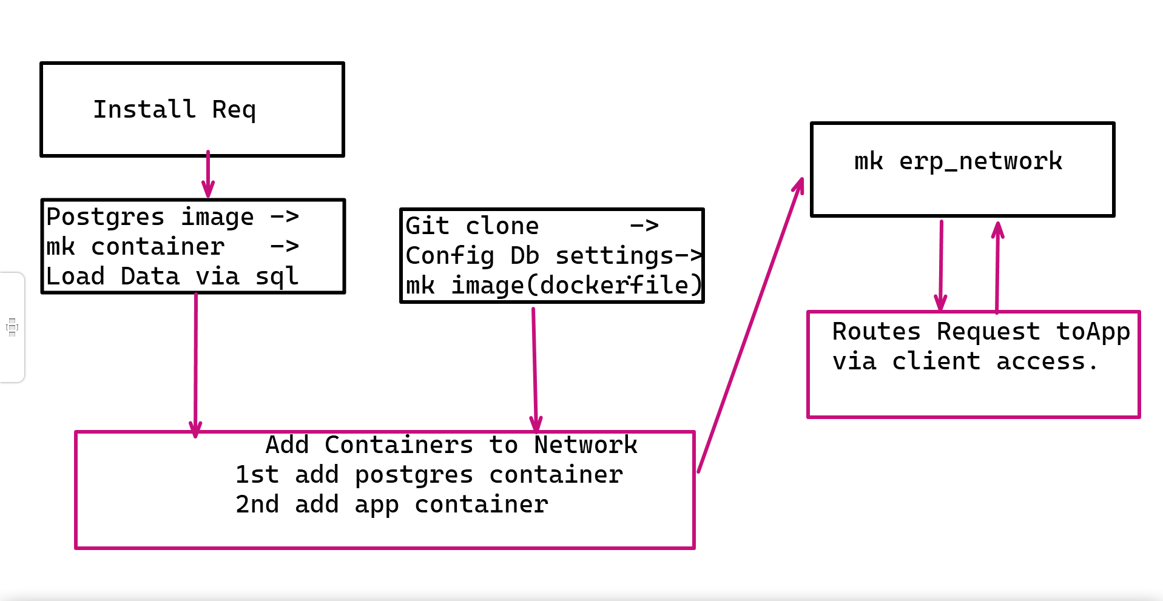
College ERP [Django] Category : DevOps using Amazon AWS
LEVEL 3 PPT PRESENTATION
Date :

Slide 5
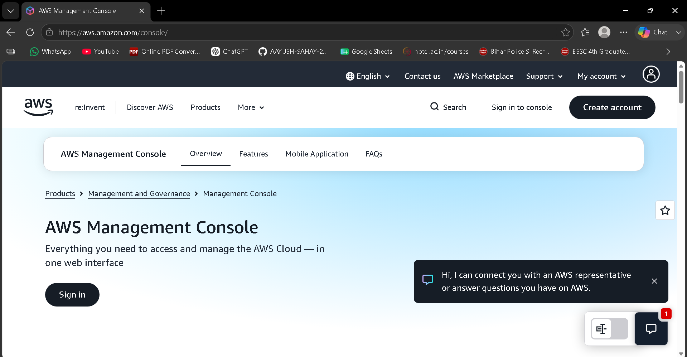
College ERP [Django] Category : DevOps using Amazon AWS
LEVEL 3 PPT PRESENTATION
Date :

Slide 6
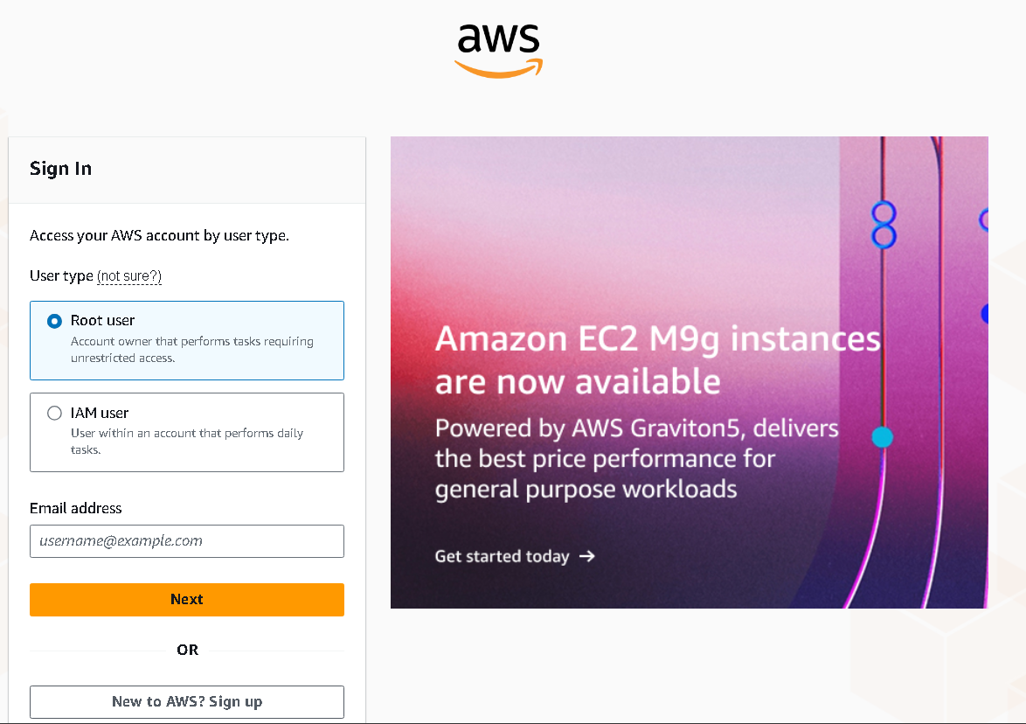
College ERP [Django] Category : DevOps using Amazon AWS
LEVEL 3 PPT PRESENTATION
Date :

Slide 7
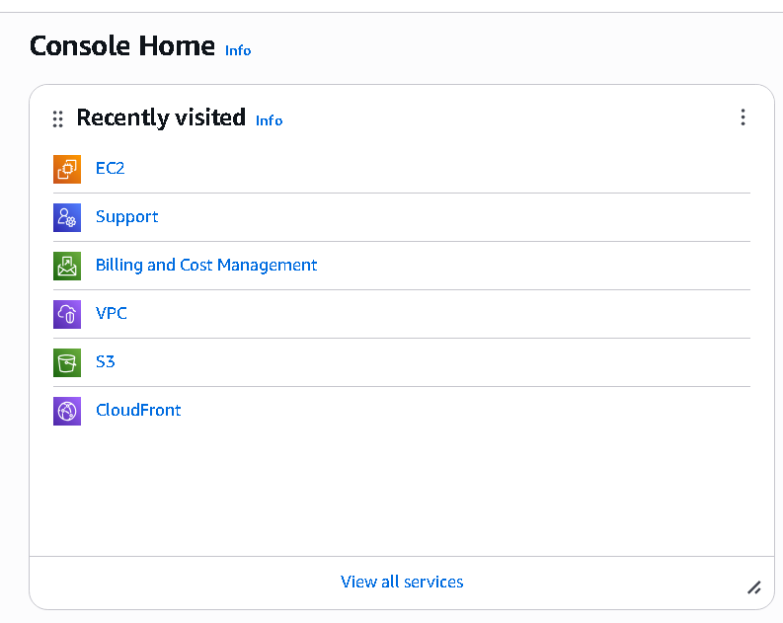
College ERP [Django] Category : DevOps using Amazon AWS
LEVEL 3 PPT PRESENTATION
Date :

Slide 8
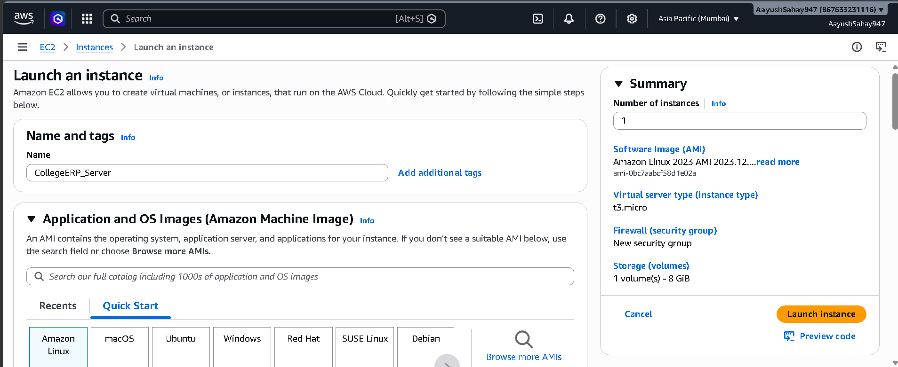
College ERP [Django] Category : DevOps using Amazon AWS
LEVEL 3 PPT PRESENTATION
Date :

Slide 9
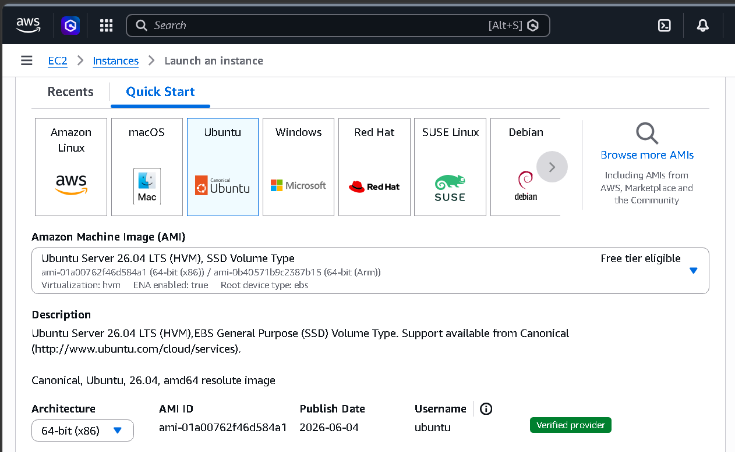
College ERP [Django] Category : DevOps using Amazon AWS
LEVEL 3 PPT PRESENTATION
Date :

Slide 10
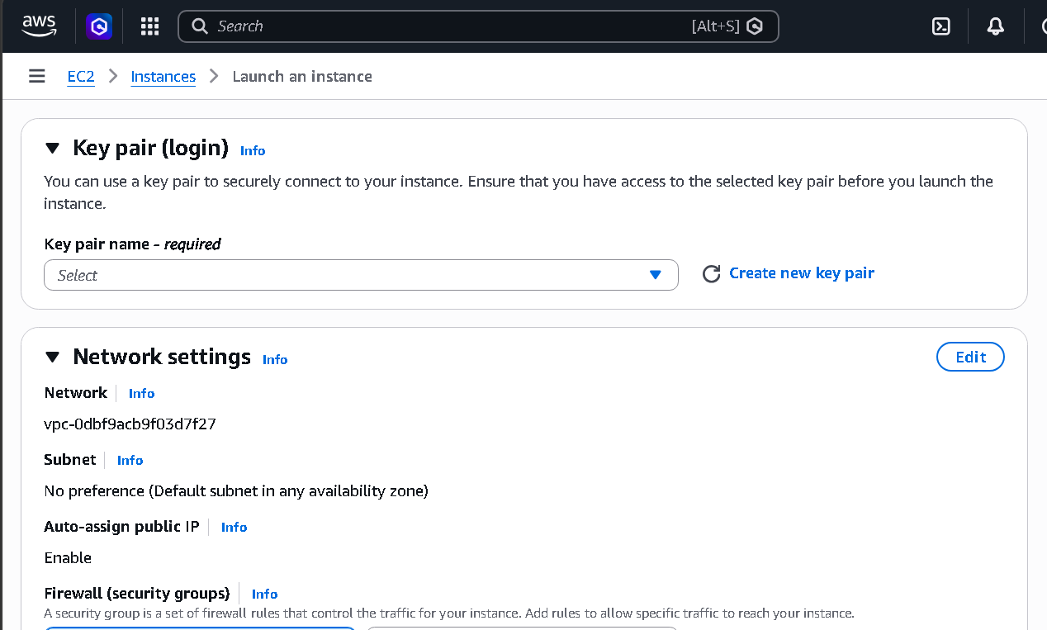
College ERP [Django] Category : DevOps using Amazon AWS
LEVEL 3 PPT PRESENTATION
Date :

Slide 11
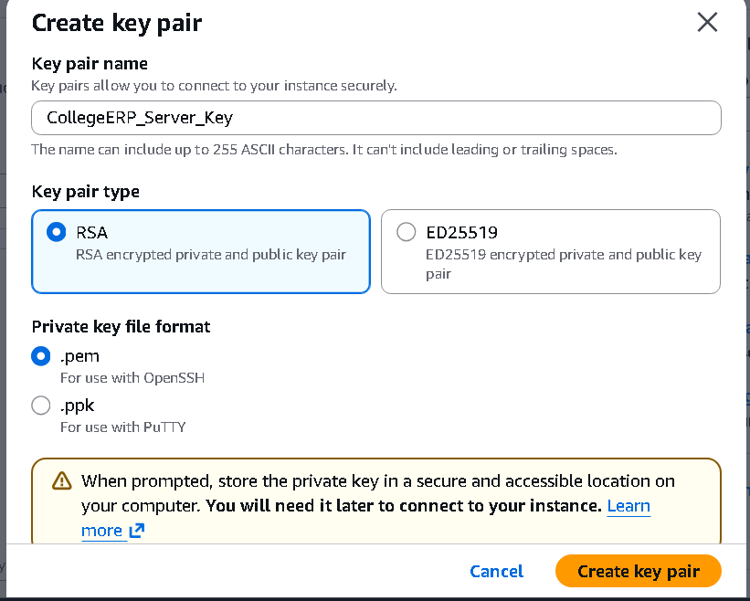
College ERP [Django] Category : DevOps using Amazon AWS
LEVEL 3 PPT PRESENTATION
Date :

Slide 12
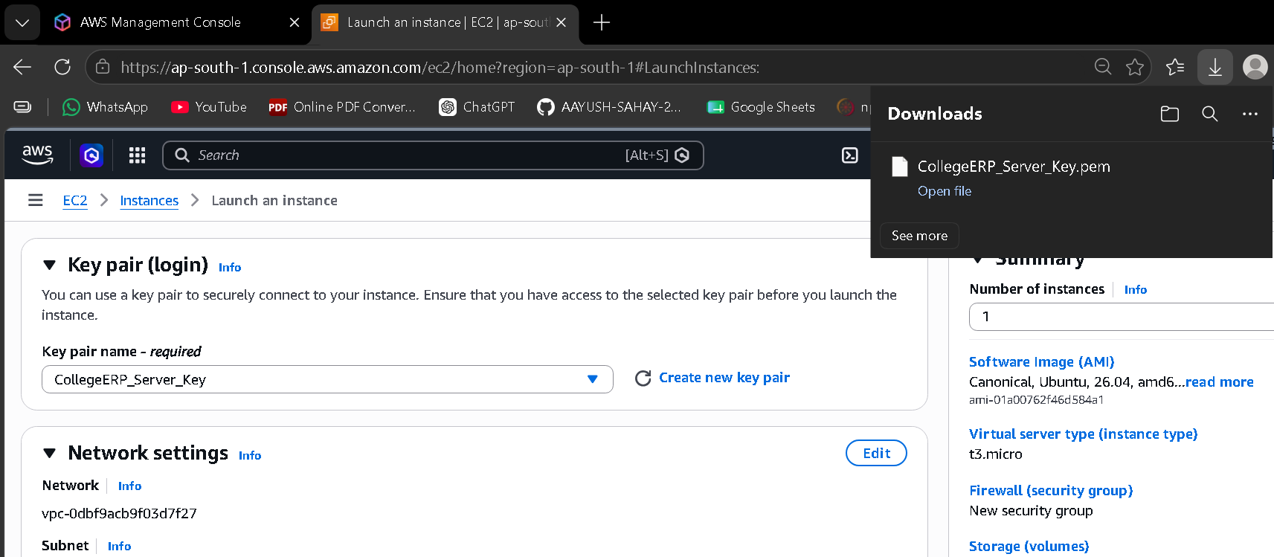
College ERP [Django] Category : DevOps using Amazon AWS
LEVEL 3 PPT PRESENTATION
Date :

Slide 13
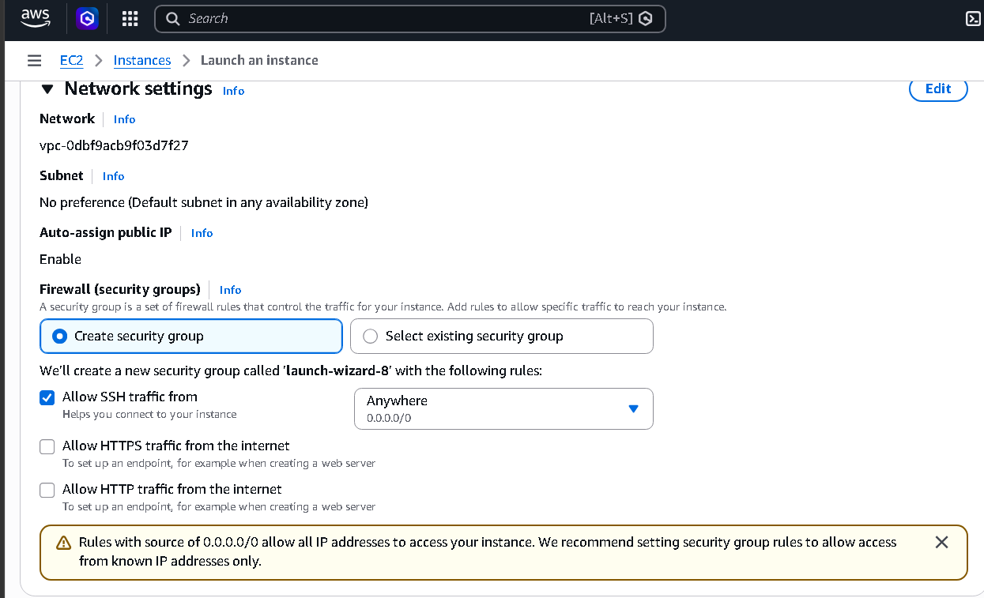
College ERP [Django] Category : DevOps using Amazon AWS
LEVEL 3 PPT PRESENTATION
Date :

Slide 14
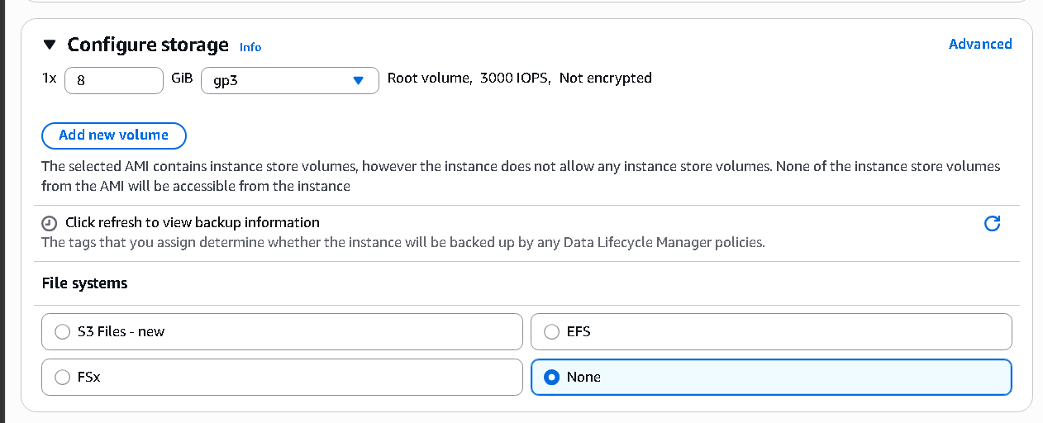
College ERP [Django] Category : DevOps using Amazon AWS
LEVEL 3 PPT PRESENTATION
Date :

Slide 15
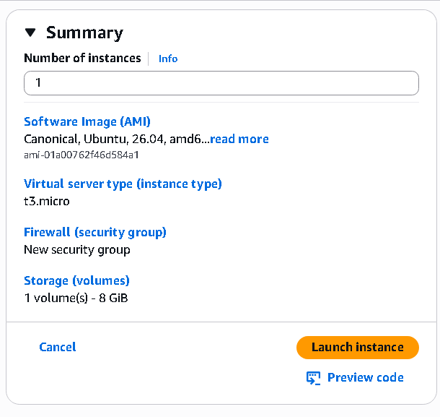
College ERP [Django] Category : DevOps using Amazon AWS
LEVEL 3 PPT PRESENTATION
Date :

Slide 16
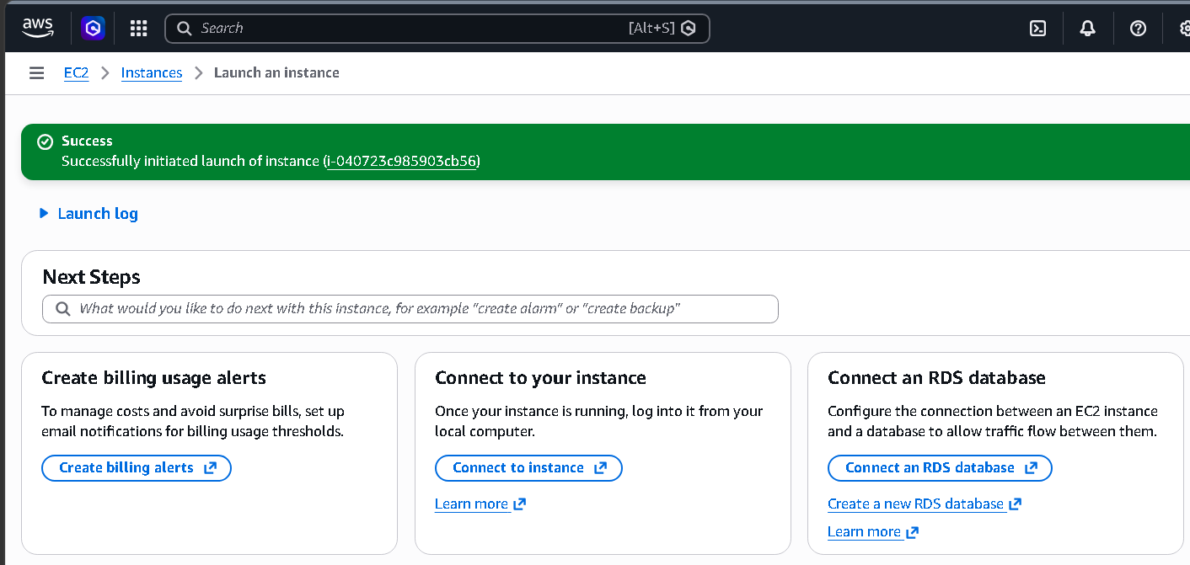
College ERP [Django] Category : DevOps using Amazon AWS
LEVEL 3 PPT PRESENTATION
Date :

Slide 17
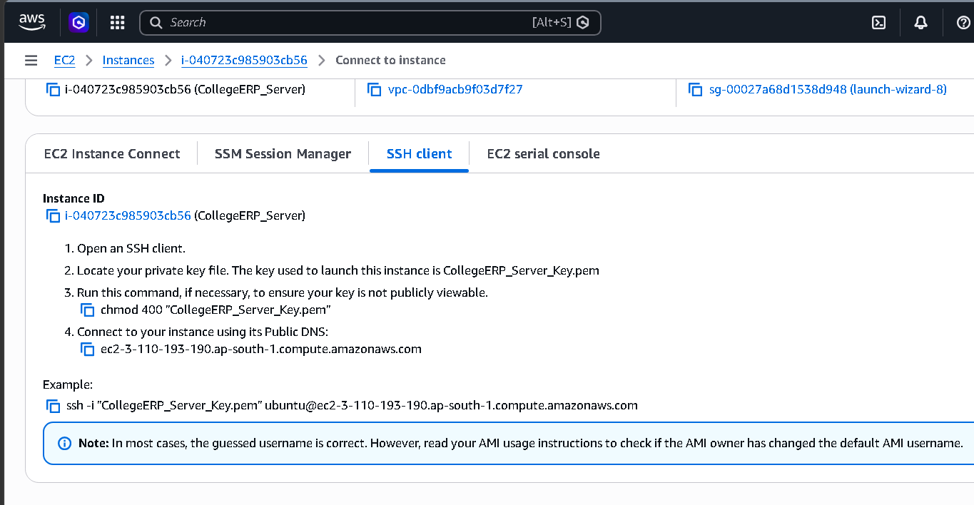
College ERP [Django] Category : DevOps using Amazon AWS
LEVEL 3 PPT PRESENTATION
Date :

Slide 18
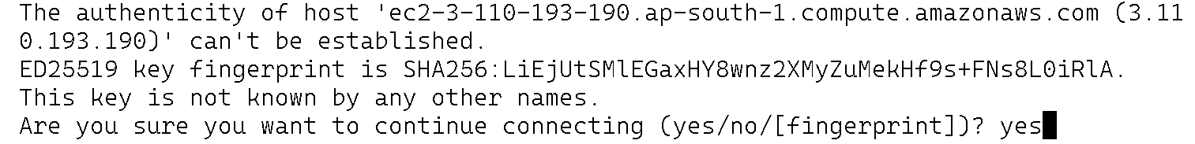
College ERP [Django] Category : DevOps using Amazon AWS
LEVEL 3 PPT PRESENTATION
Date :

Slide 19
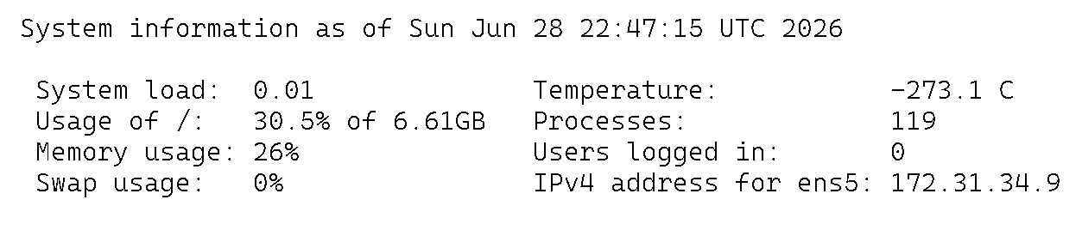
College ERP [Django] Category : DevOps using Amazon AWS
LEVEL 3 PPT PRESENTATION
Date :

Slide 20
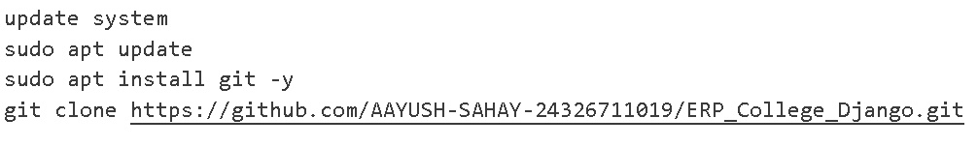
College ERP [Django] Category : DevOps using Amazon AWS
LEVEL 3 PPT PRESENTATION
Date :

Slide 21
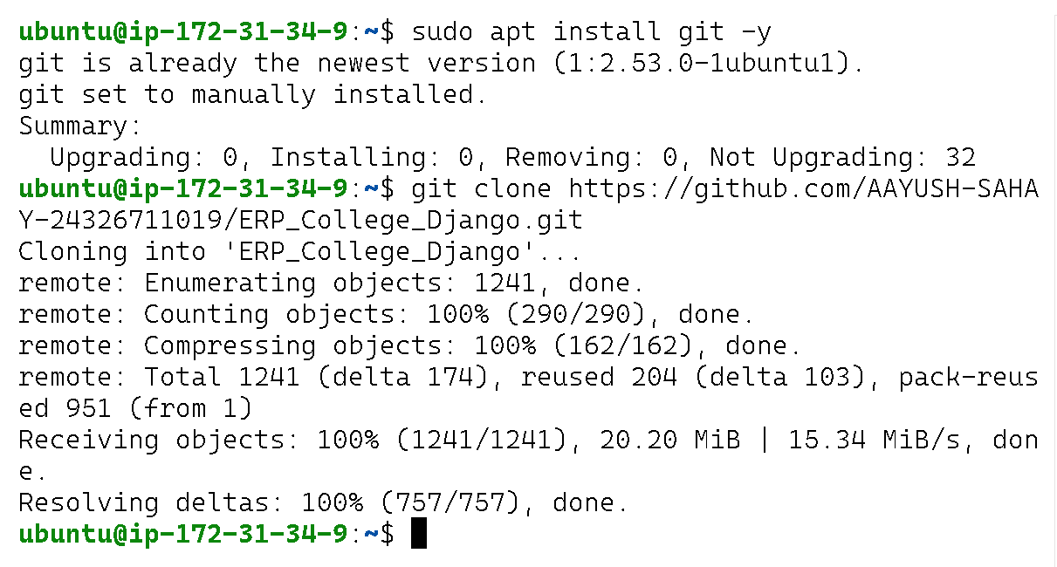
College ERP [Django] Category : DevOps using Amazon AWS
LEVEL 3 PPT PRESENTATION
Date :

Slide 22
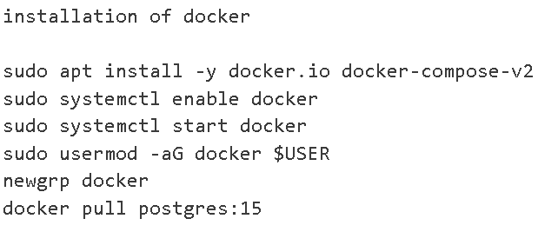
College ERP [Django] Category : DevOps using Amazon AWS
LEVEL 3 PPT PRESENTATION
Date :

Slide 23
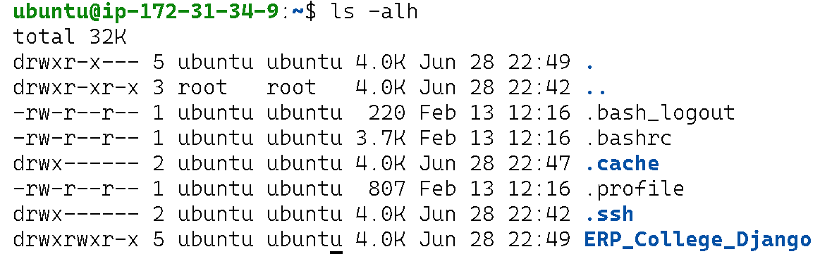
College ERP [Django] Category : DevOps using Amazon AWS
LEVEL 3 PPT PRESENTATION
Date :

Slide 24
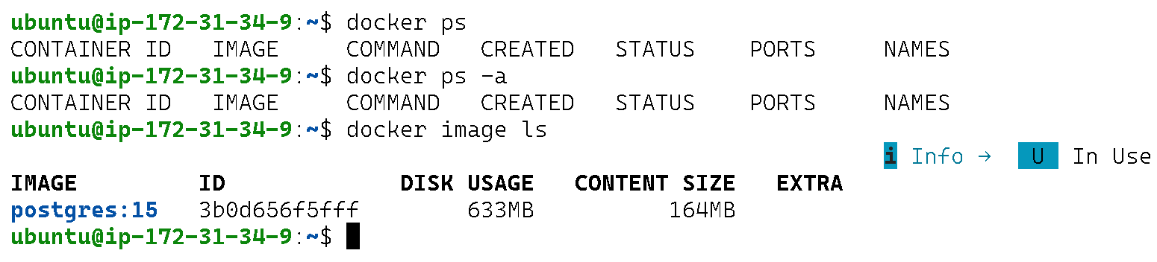
College ERP [Django] Category : DevOps using Amazon AWS
LEVEL 3 PPT PRESENTATION
Date :

Slide 25
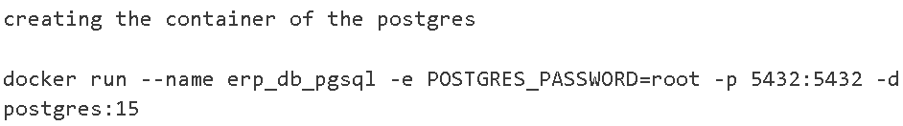
College ERP [Django] Category : DevOps using Amazon AWS
LEVEL 3 PPT PRESENTATION
Date :

Slide 26
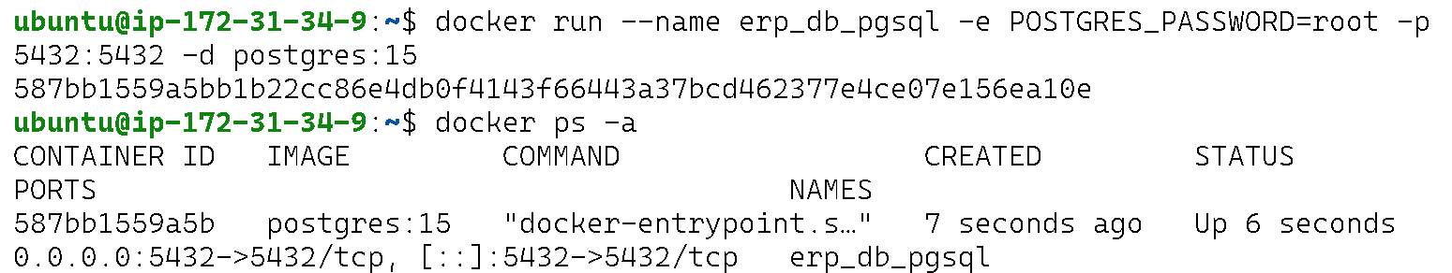
College ERP [Django] Category : DevOps using Amazon AWS
LEVEL 3 PPT PRESENTATION
Date :

Slide 27

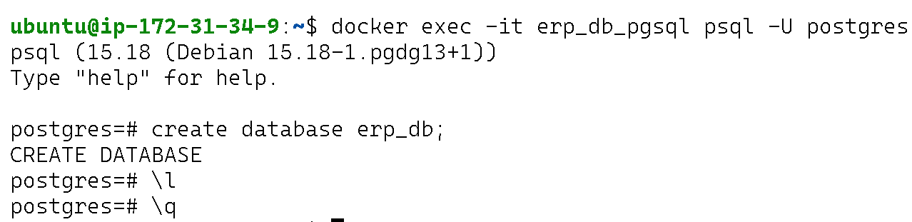
College ERP [Django] Category : DevOps using Amazon AWS
LEVEL 3 PPT PRESENTATION
Date :

Slide 28
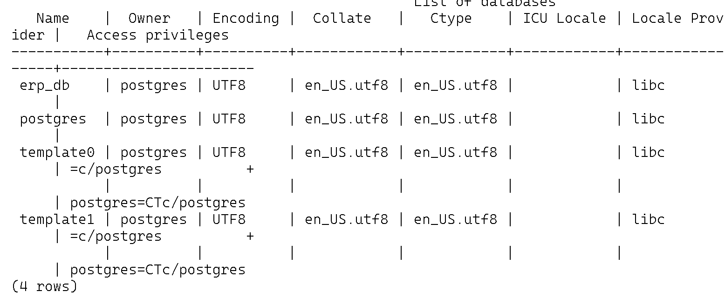
College ERP [Django] Category : DevOps using Amazon AWS
LEVEL 3 PPT PRESENTATION
Date :

Slide 29
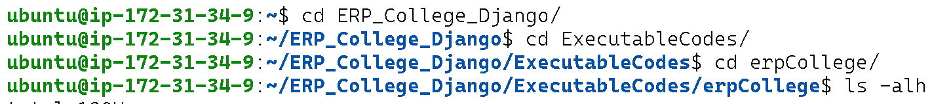
College ERP [Django] Category : DevOps using Amazon AWS
LEVEL 3 PPT PRESENTATION
Date :

Slide 30
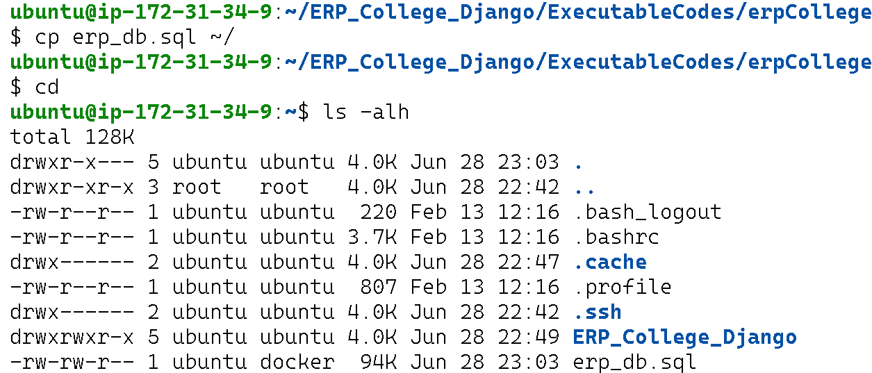
College ERP [Django] Category : DevOps using Amazon AWS
LEVEL 3 PPT PRESENTATION
Date :

Slide 31

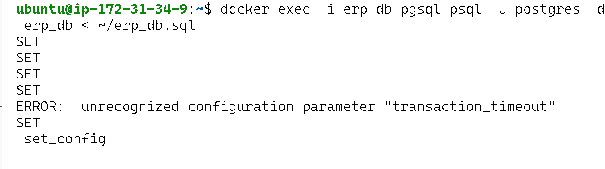
College ERP [Django] Category : DevOps using Amazon AWS
LEVEL 3 PPT PRESENTATION
Date :

Slide 32
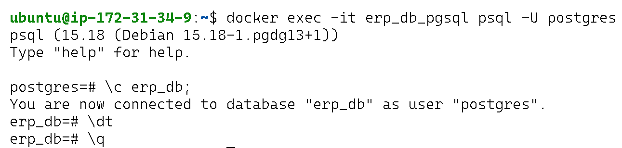
College ERP [Django] Category : DevOps using Amazon AWS
LEVEL 3 PPT PRESENTATION
Date :

Slide 33
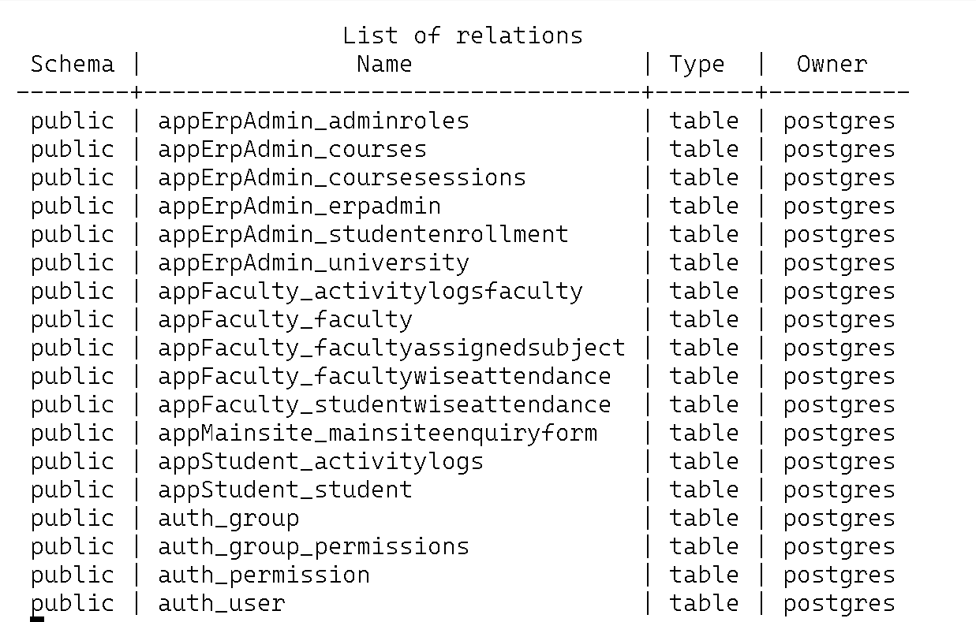
College ERP [Django] Category : DevOps using Amazon AWS
LEVEL 3 PPT PRESENTATION
Date :

Slide 34
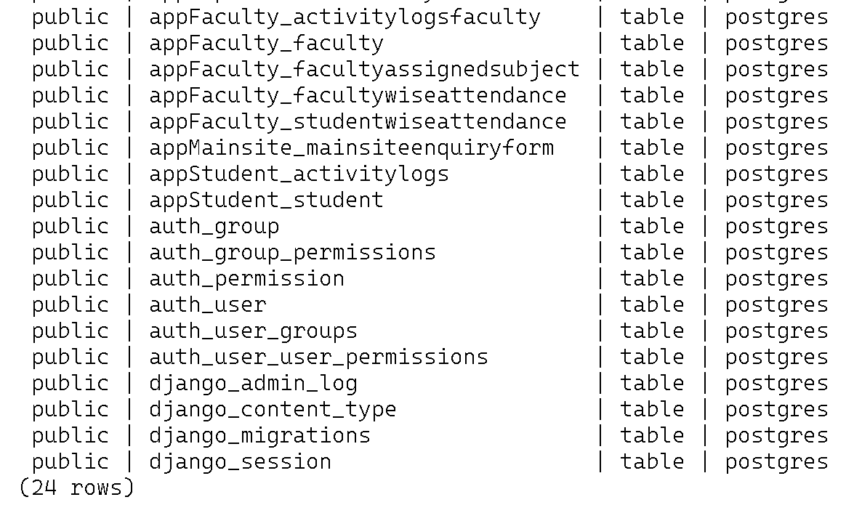
College ERP [Django] Category : DevOps using Amazon AWS
LEVEL 3 PPT PRESENTATION
Date :

Slide 35
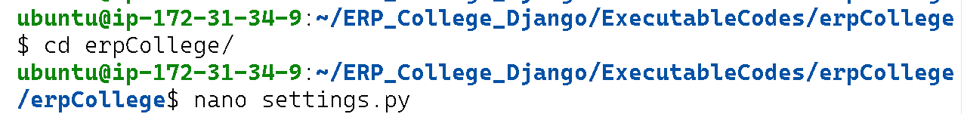
College ERP [Django] Category : DevOps using Amazon AWS
LEVEL 3 PPT PRESENTATION
Date :

Slide 36
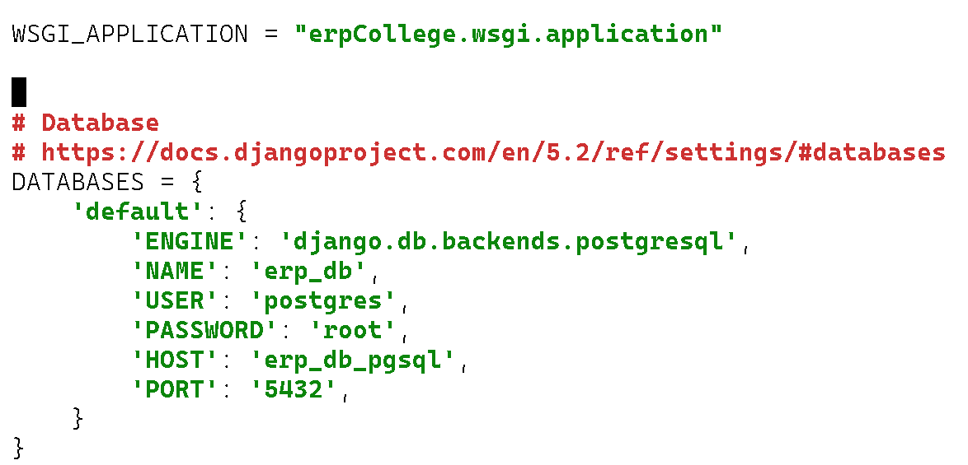
College ERP [Django] Category : DevOps using Amazon AWS
LEVEL 3 PPT PRESENTATION
Date :

Slide 37
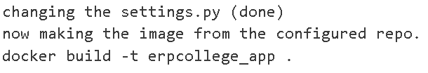
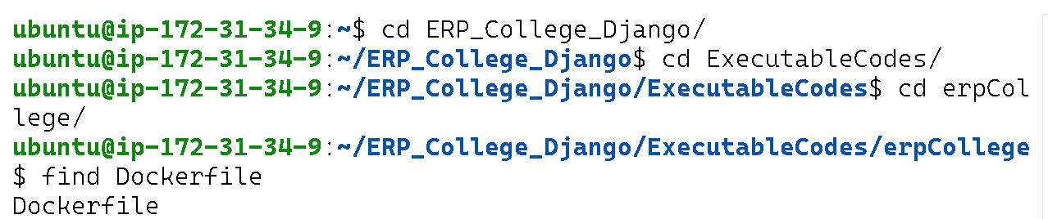
College ERP [Django] Category : DevOps using Amazon AWS
LEVEL 3 PPT PRESENTATION
Date :

Slide 38
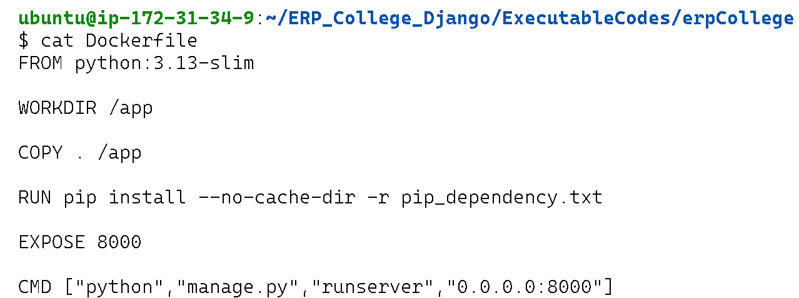
College ERP [Django] Category : DevOps using Amazon AWS
LEVEL 3 PPT PRESENTATION
Date :

Slide 39
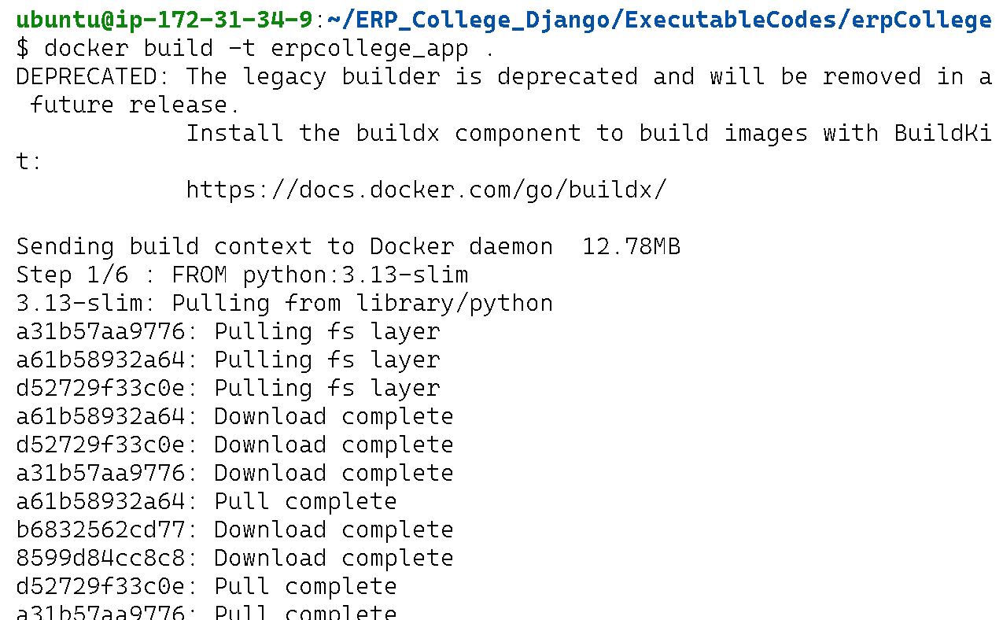
College ERP [Django] Category : DevOps using Amazon AWS
LEVEL 3 PPT PRESENTATION
Date :

Slide 40
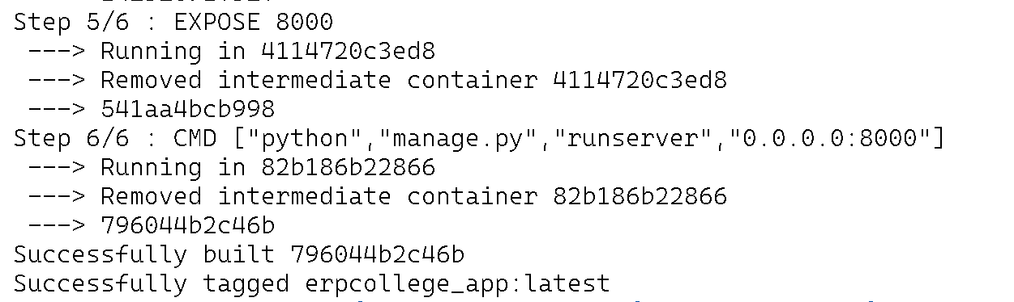
College ERP [Django] Category : DevOps using Amazon AWS
LEVEL 3 PPT PRESENTATION
Date :

Slide 41
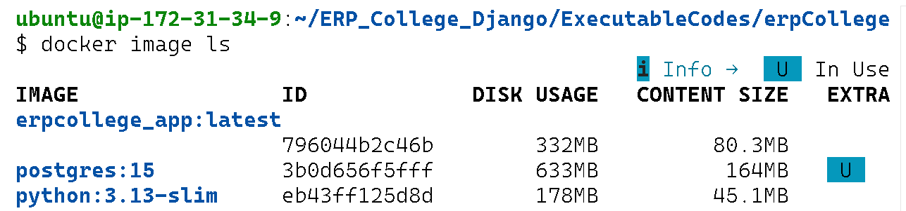
College ERP [Django] Category : DevOps using Amazon AWS
LEVEL 3 PPT PRESENTATION
Date :

Slide 42
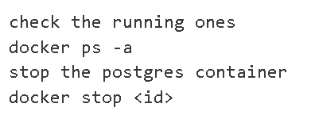
College ERP [Django] Category : DevOps using Amazon AWS
LEVEL 3 PPT PRESENTATION
Date :

Slide 43
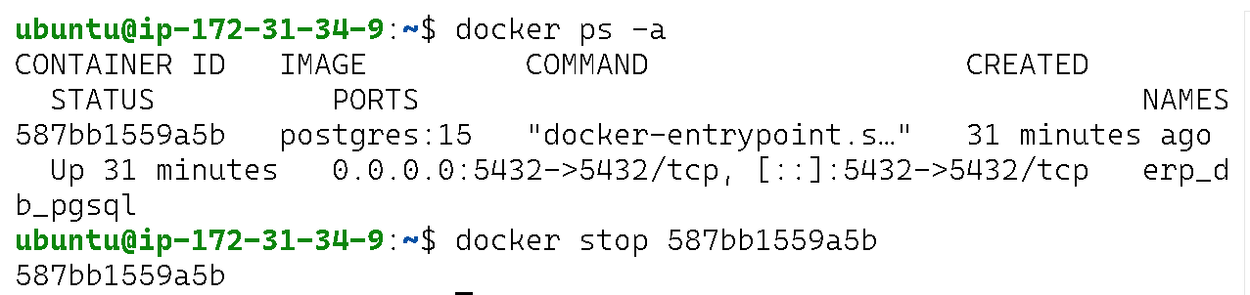
College ERP [Django] Category : DevOps using Amazon AWS
LEVEL 3 PPT PRESENTATION
Date :

Slide 44
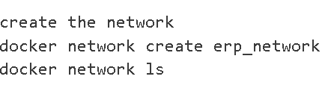
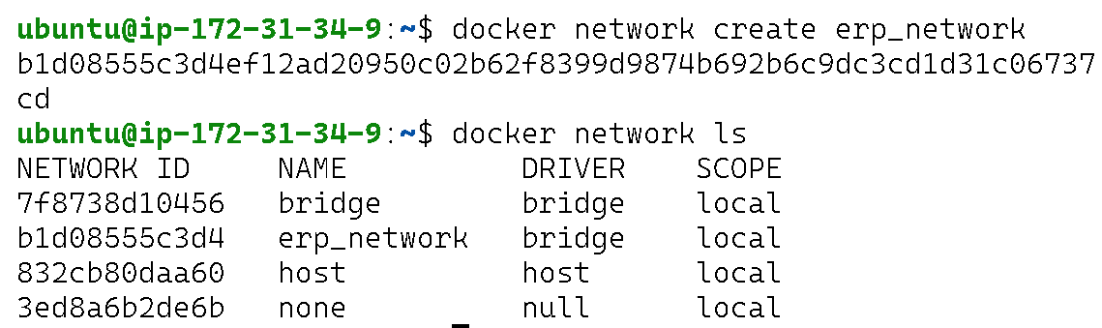
College ERP [Django] Category : DevOps using Amazon AWS
LEVEL 3 PPT PRESENTATION
Date :

Slide 45
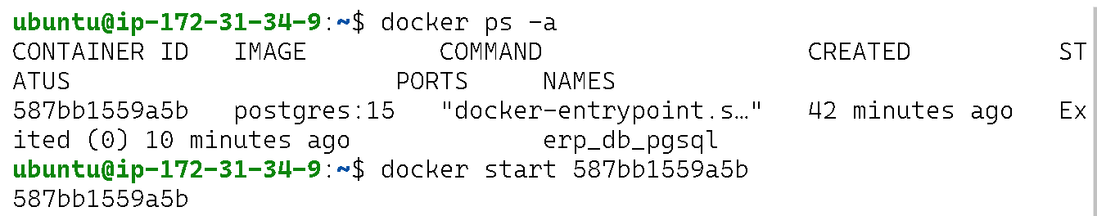
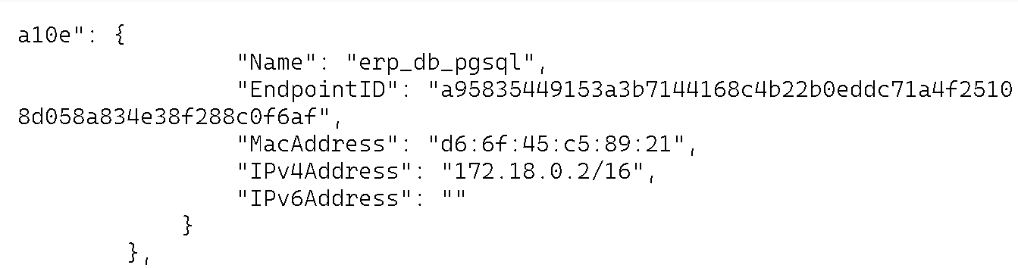
College ERP [Django] Category : DevOps using Amazon AWS
LEVEL 3 PPT PRESENTATION
Date :

Slide 46

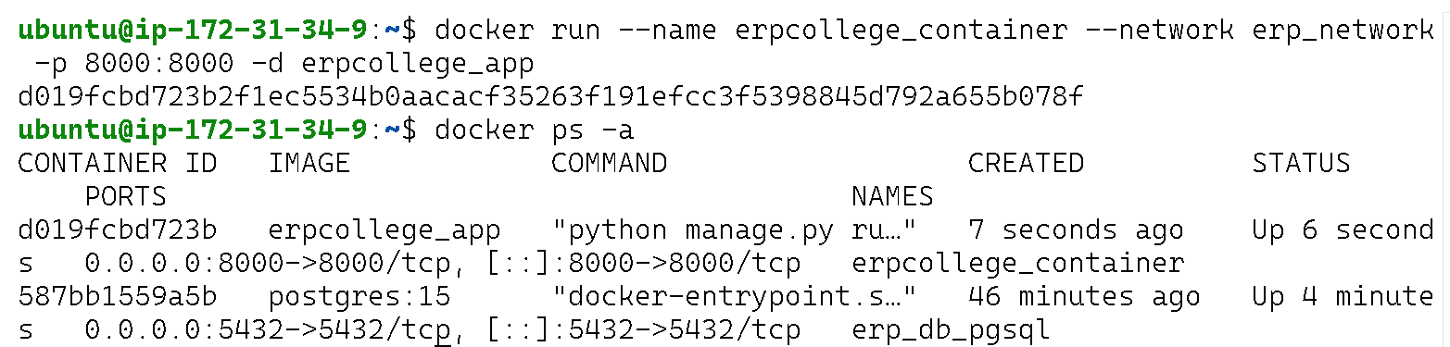
College ERP [Django] Category : DevOps using Amazon AWS
LEVEL 3 PPT PRESENTATION
Date :

Slide 47
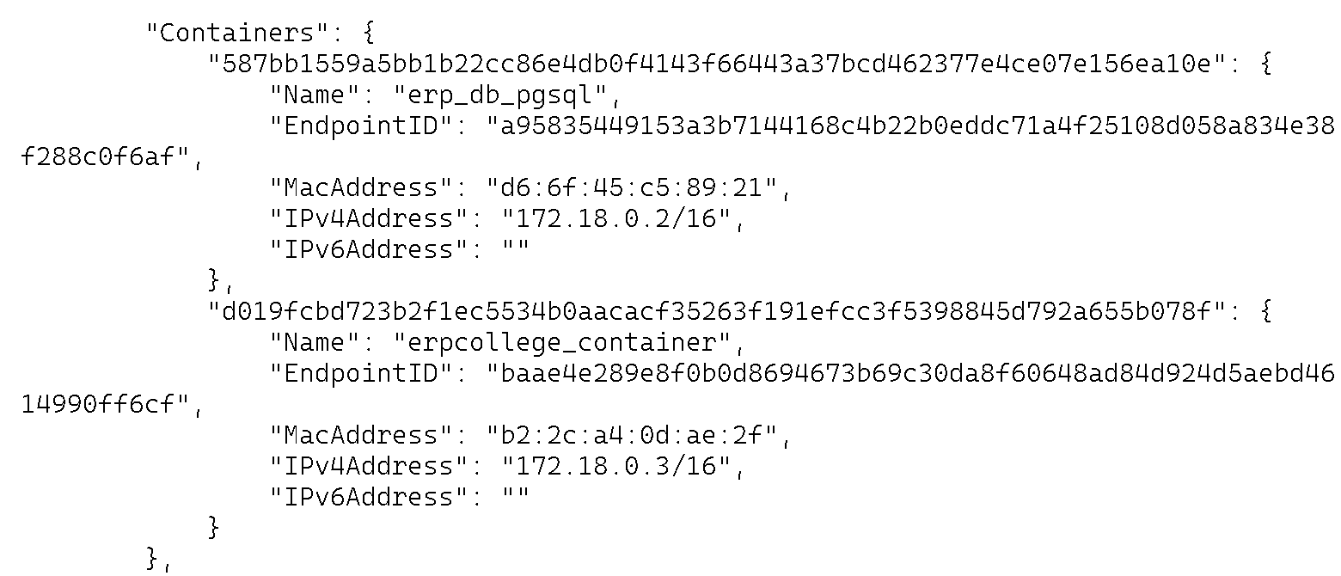
College ERP [Django] Category : DevOps using Amazon AWS
LEVEL 3 PPT PRESENTATION
Date :

Slide 48
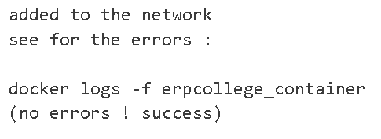
College ERP [Django] Category : DevOps using Amazon AWS
LEVEL 3 PPT PRESENTATION
Date :

Slide 49
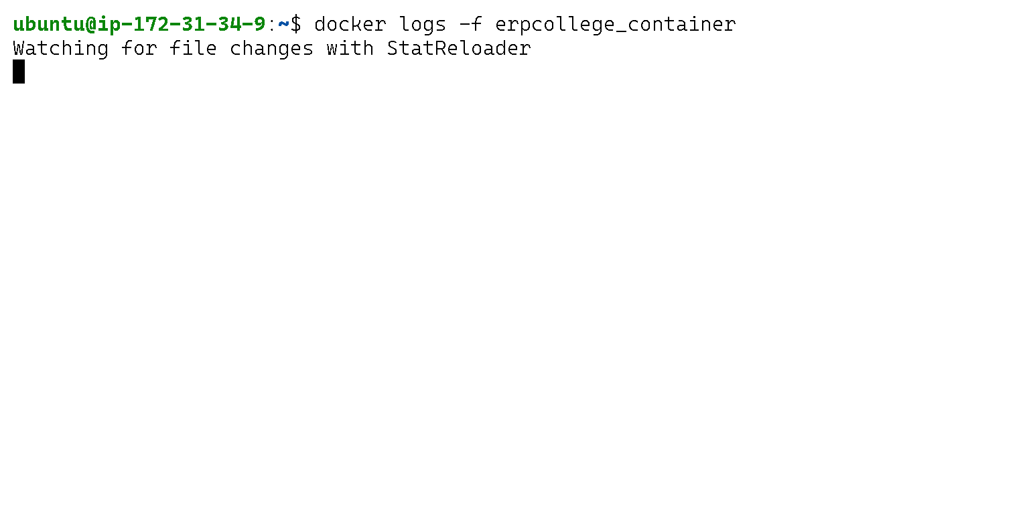
College ERP [Django] Category : DevOps using Amazon AWS
LEVEL 3 PPT PRESENTATION
Date :

Slide 50

College ERP [Django] Category : DevOps using Amazon AWS
LEVEL 3 PPT PRESENTATION
Date :

Slide 51

College ERP [Django] Category : DevOps using Amazon AWS
LEVEL 3 PPT PRESENTATION
Date :

Slide 52

College ERP [Django] Category : DevOps using Amazon AWS
LEVEL 3 PPT PRESENTATION
Date :

Slide 53

College ERP [Django] Category : DevOps using Amazon AWS
LEVEL 3 PPT PRESENTATION
Date :

Slide 54

College ERP [Django] Category : DevOps using Amazon AWS
LEVEL 3 PPT PRESENTATION
Date :

Slide 55

College ERP [Django] Category : DevOps using Amazon AWS
LEVEL 3 PPT PRESENTATION
Date :

Slide 56

College ERP [Django] Category : DevOps using Amazon AWS
LEVEL 3 PPT PRESENTATION
Date :

Slide 57

College ERP [Django] Category : DevOps using Amazon AWS
LEVEL 3 PPT PRESENTATION
Date :

Slide 58

College ERP [Django] Category : DevOps using Amazon AWS
LEVEL 3 PPT PRESENTATION
Date :

Slide 59

College ERP [Django] Category : DevOps using Amazon AWS
LEVEL 3 PPT PRESENTATION
Date :

Slide 60

College ERP [Django] Category : DevOps using Amazon AWS
LEVEL 3 PPT PRESENTATION
Date :

Slide 61

College ERP [Django] Category : DevOps using Amazon AWS
LEVEL 3 PPT PRESENTATION
Date :

Slide 62

College ERP [Django] Category : DevOps using Amazon AWS
LEVEL 3 PPT PRESENTATION
Date :

Slide 63

College ERP [Django] Category : DevOps using Amazon AWS
LEVEL 3 PPT PRESENTATION
Date :

Slide 64

College ERP [Django] Category : DevOps using Amazon AWS
LEVEL 2 PPT PRESENTATION
End of Presentation
College ERP : Django & Pgsql
Date :
Thank you !

